Slide 1
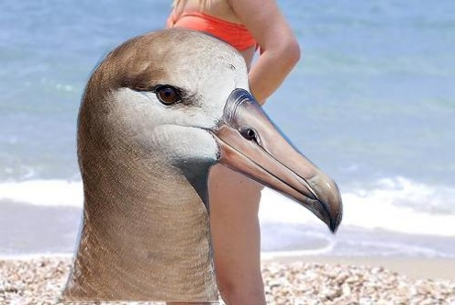
CLIP on Waterbirds
A black-box study of CLIP ViT-B/32
Does accuracy differ by background?
Can visible text change the prediction?
Group: Four horsemen of the apocalypse
Participant: K12348049, K52104490, K12518385, K01635875
Notes:
In Phase One, we tested how CLIP classifies images of landbirds and waterbirds. We asked two questions. First, does accuracy differ when the bird appears on a land or water background? Second, does adding visible text change the model’s prediction on the same image? We treated CLIP as a black box and compared its predictions and image–text scores.
Source: Phase_1/Manual Team/Analysis.ipynb, Sections 2–3.

Slide 2
Baseline and background bias
Notebook sections 1–7
Setup and dataset
71.0% overall test accuracy
Two fixed class prompts for 5,794 test
images across four subgroups.
Bird class | Background | Accuracy
Landbird | Land | 87.5%
Landbird | Water | 45.1%
Waterbird | Land | 79.3%
Waterbird | Water | 99.2%
Evaluation
Accuracy, errors, confusion matrix,
and true-class logit margins.
The subgroup gaps show an association with background.
Notes:
We scored the full Waterbirds test split with two fixed prompts, one for each bird class. The AI group flagged labels for three species, which we corrected in a separate copy. Overall accuracy was 71 percent. Landbirds were classified correctly about 88 percent of the time on land and 45 percent on water. Waterbirds also scored higher on their matching background. Because the subgroups contain different images, these gaps show an association with background.
Source: Phase_1/Manual Team/Analysis.ipynb, Sections 3–7 and Section 12 saved baseline report.

Slide 3
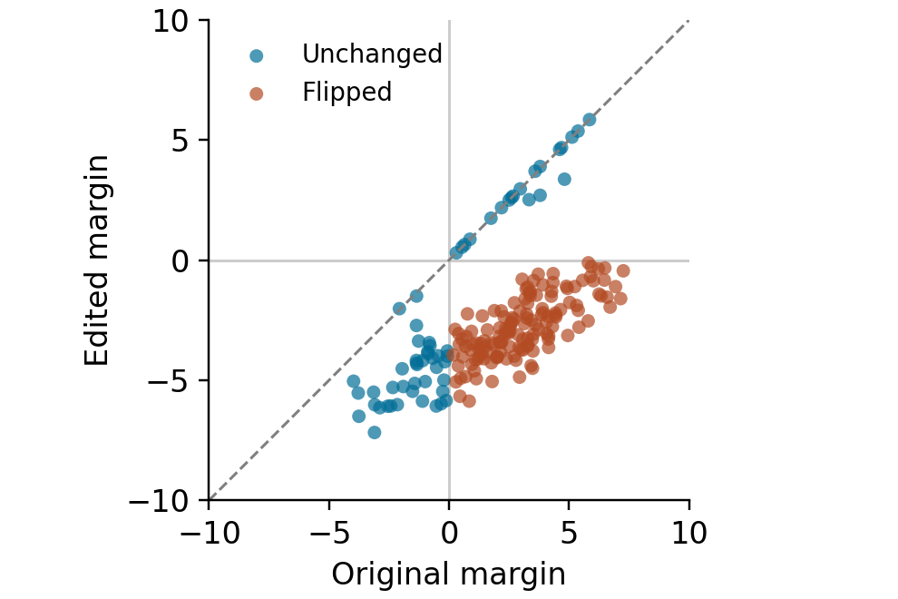
Typographic attacks
Notebook sections 8–12
Prediction shift with misleading text
200 original images, 50 per subgroup
80.0% accuracy before overlays
Overlay | Accuracy after | Flip rate
Correct | 99.0% | 19.0%
Misleading | 10.0% | 70.0%
Neutral | 82.5% | 7.5%
The midpoint report records flip directions, margin changes, and experimental settings.
Notes:
We sampled 50 images from each of the four subgroups and added correct, misleading, or neutral text to copies of each image. Accuracy on those 200 originals was 80 percent. With misleading text, it fell to 10 percent, and 70 percent of predictions flipped. Each dot compares one image’s true-class score margin before and after misleading text. Below the dashed line, the margin fell after editing. Orange dots mark prediction flips. The blue dots show how far the margin can move while the prediction stays the same. The midpoint notebook includes the plots and records the settings.
Source: Phase_1/Manual Team/Analysis.ipynb, Sections 8–12, including the prediction-shift plot in Section 10 and the attack report.

